Slide 1
Environment
Amina Akorede (2020)

Slide 2
It’s time to help the Earth.

Slide 3
It’s time to help the Earth.
Global warming is a big problem.

Slide 4
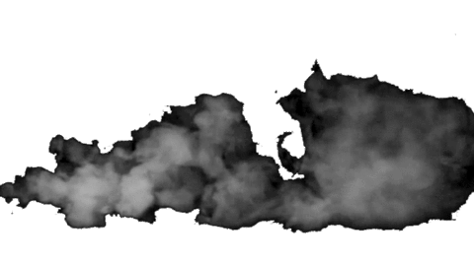
It’s time to help the Earth.
Air pollution is a big problem.

Slide 5
It’s time to help the Earth.
The Earth is sick now.

Slide 6
It’s time to help the Earth.
What can we do for the Earth?

Slide 7
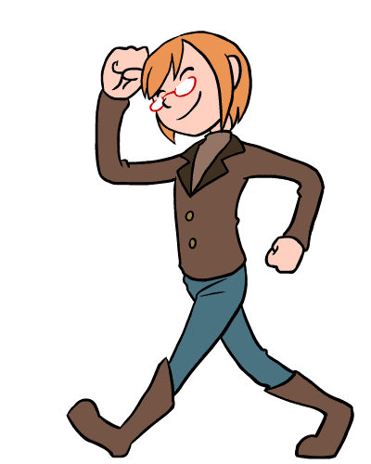
It’s time to help the Earth.
We can walk Like going to school or work.

Slide 8
It’s time to help the Earth.
We can use public transportation

Slide 9
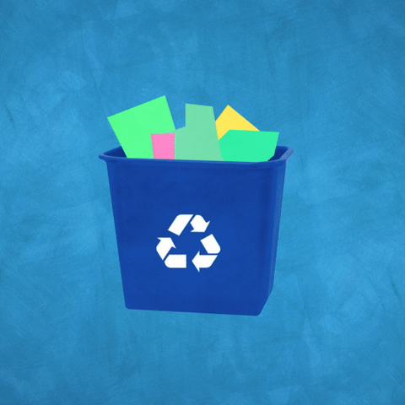
It’s time to help the Earth.
We can recycle cans and paper.

Slide 10
It’s time to help the Earth.
We can reduce waste.

Slide 11
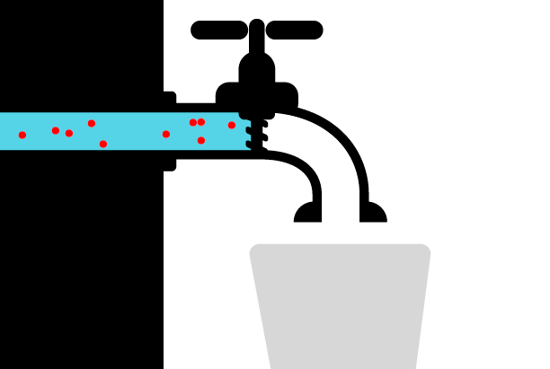
It’s time to help the Earth.
We can save water.

Slide 12
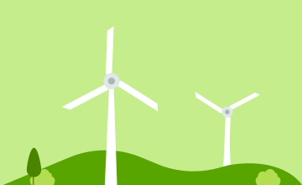
It’s time to help the Earth.
We can save energy.

Slide 13
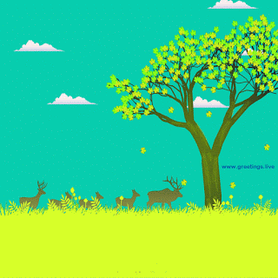
It’s time to help the Earth.
We can plant trees.

Slide 14
Environment quiz.
Boxes and plastic, etc. used for wrapping products
Packaging

Slide 15
Environment quiz.
A place where you put used bottles.
Bottle bank

Slide 16
Environment quiz.
The opposite of to waste
Save

Slide 17
Environment quiz.
To use something again in a different way.
Recycle

Slide 18
Environment quiz.
When you put something in the bin you t…………………………
Throw away

Slide 19
End

