Slide 1
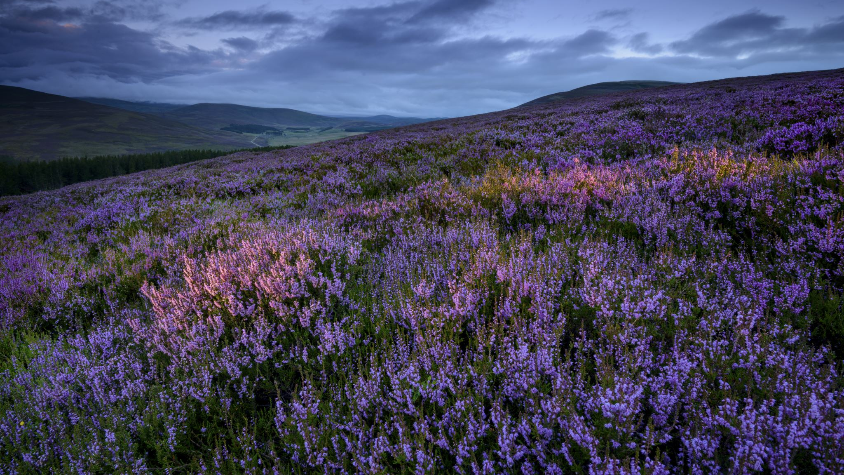
Seasons of the Year
Amina Akorede (2020)

Slide 2
A season is a part of a year.
There are four seasons in a year:
Spring, summer, autumn (British English) or fall (US English), and winter.

Slide 3
Autumn is the season when the temperature transition between summer heat and winter cold occurs only in middle and high latitudes. Most people are not happy probably because of the rain.
In Summer we go on holidays. Days are hot and dry. Most students are happy because there is no school in summer. It a season when every student is happy and says goodbye to school.
Spring is a season when flowers grow up. Flowers have different colours such as pink and green in spring days are sunnier and warmer.
Winter, coldest season of the year, between autumn and spring; Winter is the time for fun on snow and winter holidays.

Slide 4

In winter
it's very cold.
it rains.
it's rainy.
it snows.
it's snowy.

Slide 5

In summer
it's hot.
it's sunny.
People go to the beach.
People usually go on holiday.

Slide 6

In spring
it's warm.
it's nice.
people go on a picnic.

Slide 7
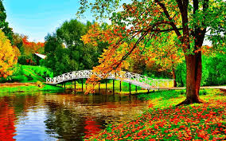
In autumn
it's often windy.
it's cloudy.
it's a bit cold

Slide 8


Slide 9


Slide 10

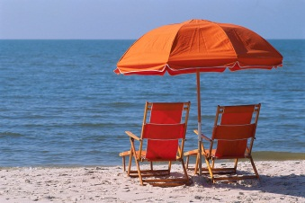

Slide 11
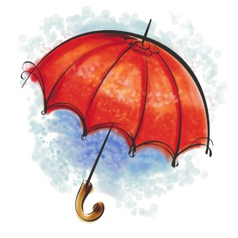



Slide 12
Questions
What is your favourite thing to do in summer?
Does it snow in your hometown in the winter? Did you use to make snowmen?
What are some things your family did when you were a child in spring?
What is the worst season in your country?
What do you think of when you think of winter?
What’s your favorite summer sport?
Which season did you enjoy most when you were a child? Why?
Do you spring clean? What kinds of things do you do at that time?
What’s your favorite winter sport?

Slide 13
END

