Slide 1
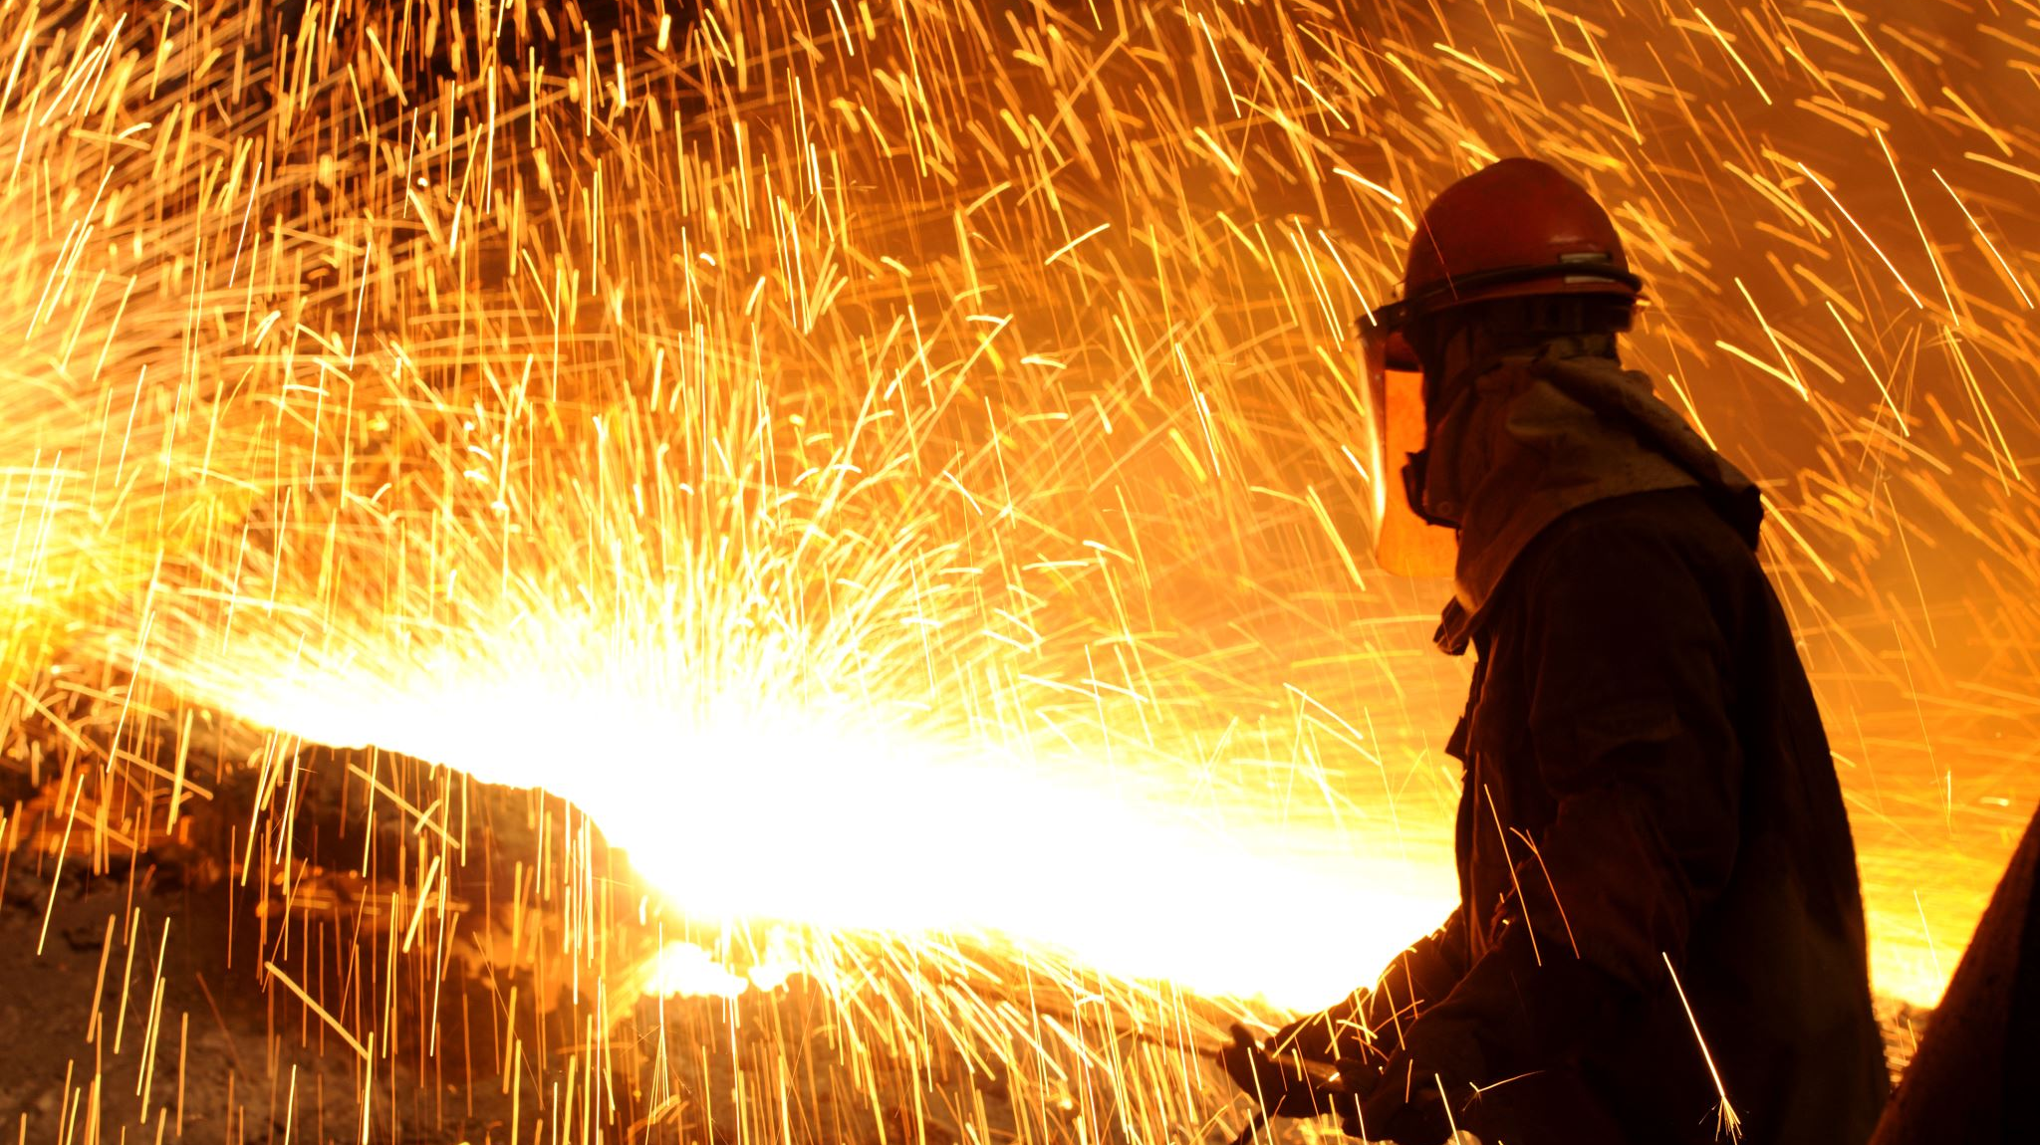
Countries and Nationalities
Amina Akorede (2020)

Slide 2
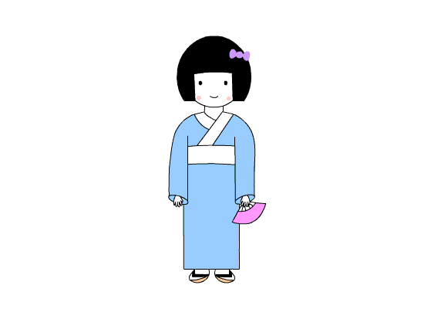
Konnichiwa! My name’s Keko and I speak Japanese.
I’m from Japan. The capital of my country is Tokio. Our national sport is sumo wrestling, but baseball is also popular. Our favorite food is fish. Izumi Motoya is a famous Japanese actor.

Slide 3
Hello ! My name’s Allison. I speak English and Spanish.
I’m from Miami, Florida, in the USA. The capital of the USA is Washington, D.C. In my country our national sports are football and baseball. Our favorite food is hamburgers. Leonardo Dicaprio is a famous American actor.

Slide 4
Namaste! My name’s Salman. I speak Hindi.
I`m from India. New Delhi is the capital city of my country. Our national sport is cricket. Curry is our traditional food. Aishwarya Rai and Karisma Kapoor are famous Indian actresses.

Slide 5
Ciao! My name’s Luigi. I speak Italian.
I`m from Milan in Italy. The capital of Italy is Rome. Italy is famous for its food. Our favorite food is pizza and pasta. Football is very popular in my country. Milan is the best team in the world! Eros Ramazzoti is a famous Italian singer.

Slide 6
Hello! I’m Talal.
I’m from Morocco.
I’m Moroccan.

Slide 7
My name is Radu.
I’m from Romania.
I’m Romanian.

Slide 8
Hello! I’m Igor.
I’m from Russia.
I’m Russian.

Slide 9
Hi! I’m Cosima.
I’m from Germany.
I’m German.

Slide 10
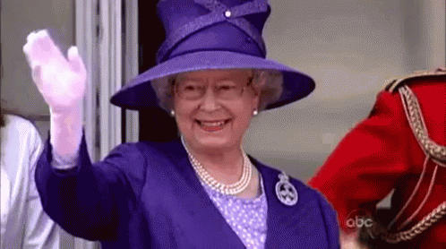
The United Kingdom
(The UK)
Where is she from?
She is from………………
British
She is ……………………
Elizabeth Queen II

Slide 11
The United States of America (The USA)
Where is he from?
American
He is from……………
He is ……………
Donald Trump

Slide 12
France
Where is he from?
He is from……………
French
Emmanuel Macron
He is……………

Slide 13
Spain
Where is he from?
He is from……………
Spanish
He is……………
Sergio Ramos

Slide 14
Korea
Where are they from?
They are from……………
Korean
They are ……………
Black Pink

Slide 15
Hello! My name is Kate. I’m from the United Kingdom.
I’m British.
What is your name?
Where are you from?
What is your nationality?

Slide 16
Write the text about your country. Use the information from the chart.

Slide 17
END

