Slide 1
Will/going to
Amina Akorede (2020)

Slide 2
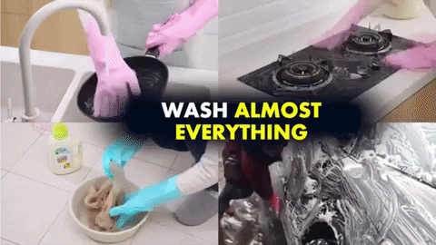
I 'vé put my gloves on because I __________________ (wash)
everything.
‘m going to wash

Slide 3
Will you help
_________________ (you/help) me with my research, please?

Slide 4
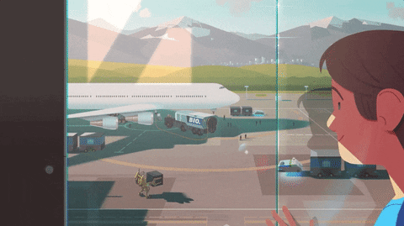
How are you going to the airport?
Luke ___________________ (give) me a lift.
‘s going to give

Slide 5
‘ll get
I’m sure they _______________ (get) married soon.

Slide 6
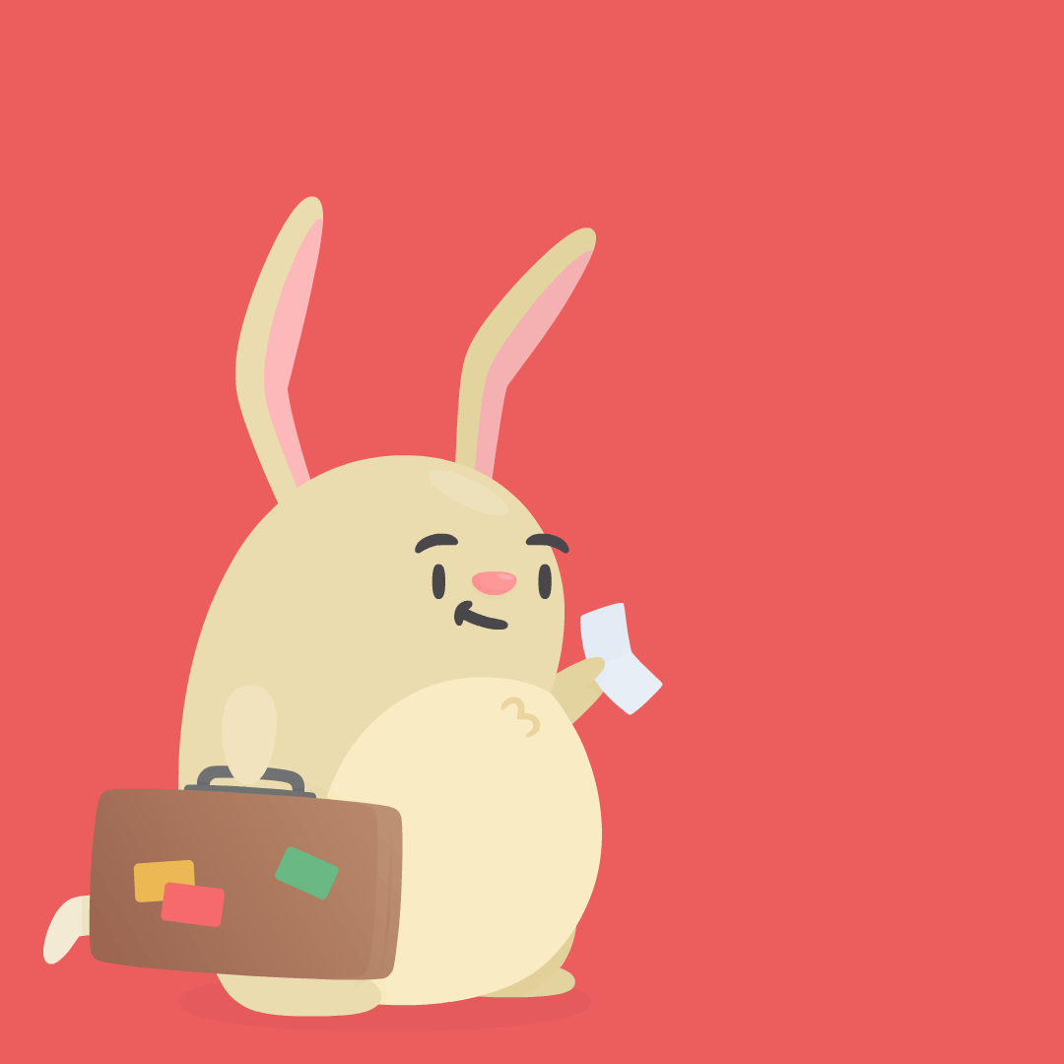
You’re leaving next week!
When _____________________ (you/pack) your suitcases.
are you going to pack

Slide 7
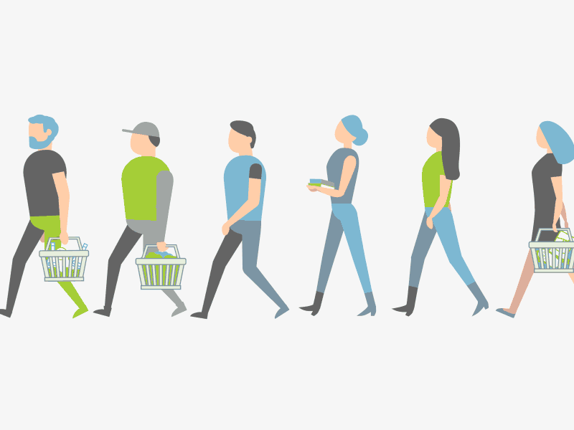
Where will they go?

Slide 8
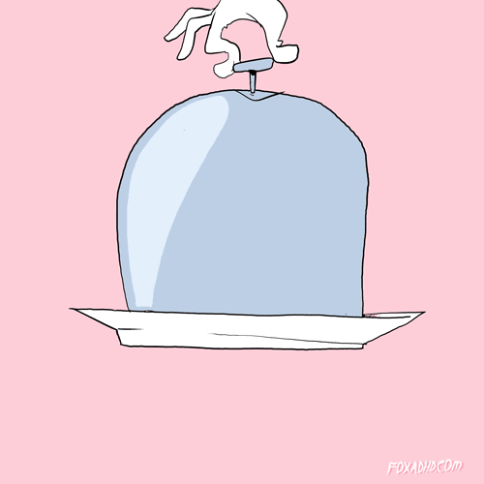
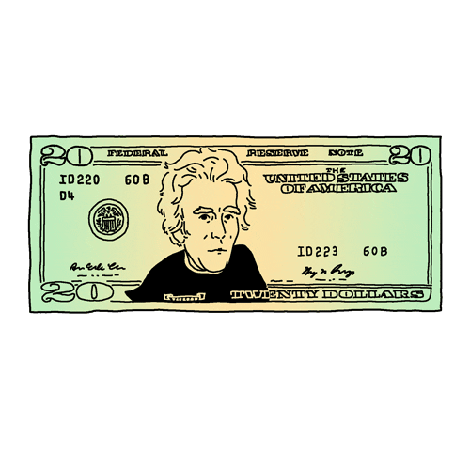
How much will you pay for this dish?

Slide 9
What will he eat?

Slide 10
What will she study?

Slide 11
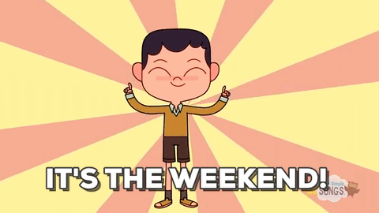
What will he do this Saturday?

Slide 12
The baby is going to sleep.
What is going to happen?

Slide 13
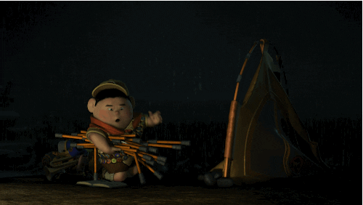
Is he going to ride his bike?
No, he isn’t. He is going to camp.

Slide 14
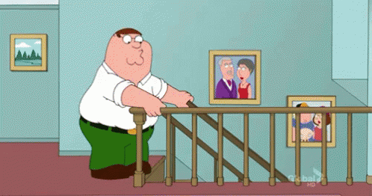
What is going to happen?
He is going to fall.

Slide 15
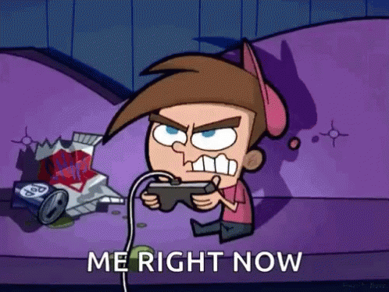
Is he going to read the book tonight?
No, he isn’t. He is going to play video games.

Slide 16
END

