Slide 1
Clauses with because
Amina Akorede (2021)

Slide 2
We can use because to give a reason for something: Eliska ate a lot because she was hungry. We can use because in an answer to a why-question: Why are you going to bed so early? ~ Because I’m tired.
Because comes before a subject + verb. We DON’T use because before a noun: Marek married Theresa because he loves her. (subject = he, verb = loves) We were late because the weather was bad. (subject = the weather, verb = was)

Slide 3
The because-clause can come first or second in the sentence: I ate a lot because I was hungry. Because I was hungry, I ate a lot.
We can begin an answer with because + subject + verb: Why are you late? ~ Because the traffic was very bad.

Slide 4
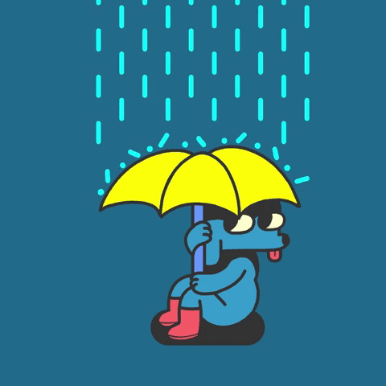
Clauses with because
I need an umbrella because it’s raining.

Slide 5
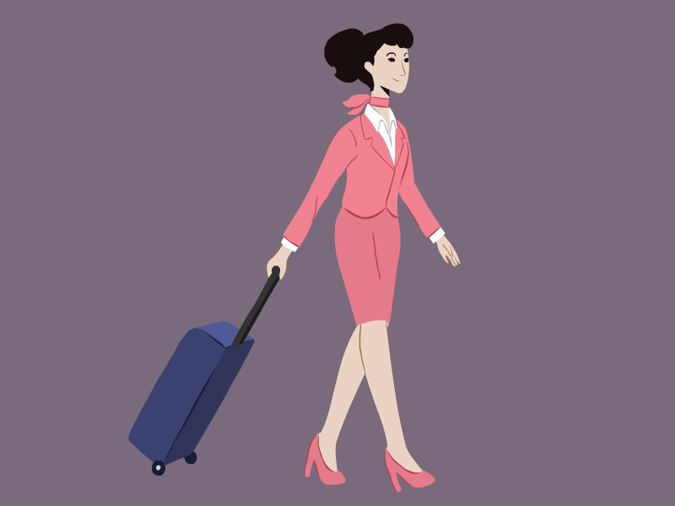
Clauses with because
I would be a good flight attendant because I´m very communicative.

Slide 6
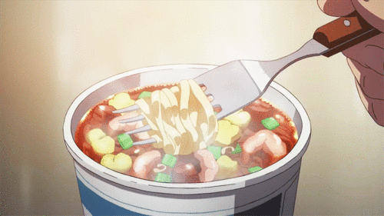
Clauses with because
My mom brought me soup because I'm sick.

Slide 7
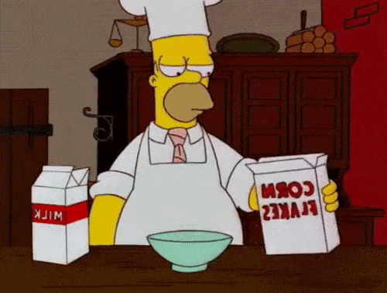
Clauses with because
I could never be a good chef because I´m the clumsy type when it comes to preparing food.

Slide 8
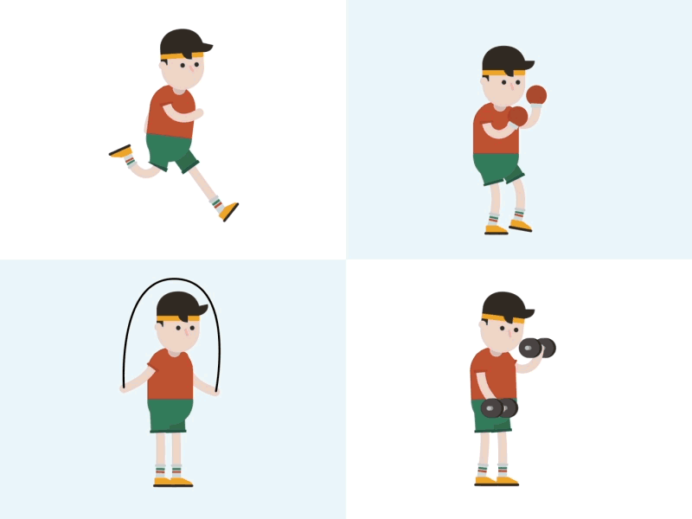
Clauses with because
I exercise because it's healthy.

Slide 9
Clauses with because
I would make a good career counselor because I´m a good advisor.

Slide 10
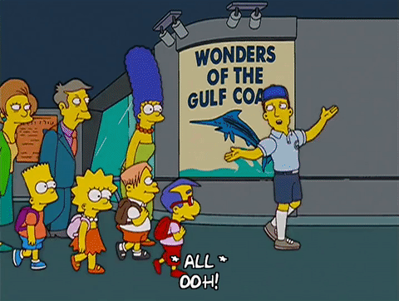
Clauses with because
I would like to be a tour guide because I´m good at speaking with people .

Slide 11
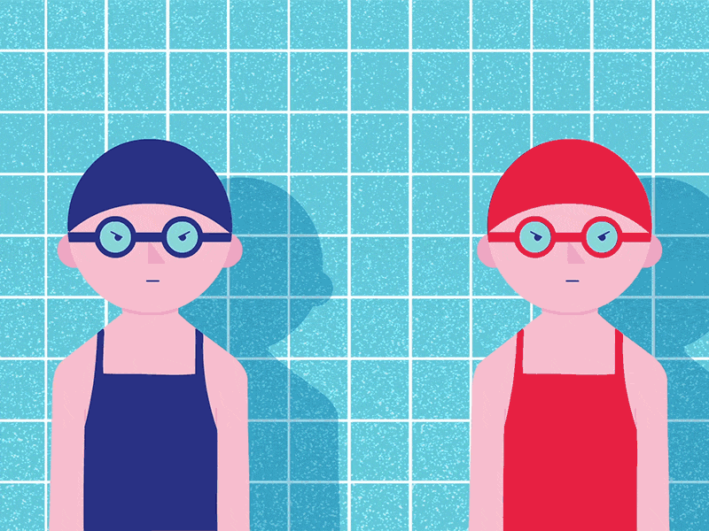
Clauses with because
Because it was hot outside, we decided
to go to the pool.

Slide 12
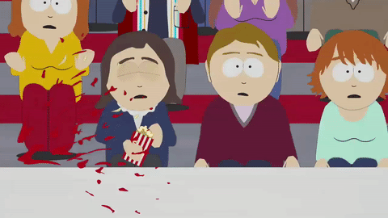
Clauses with because
I wouldn´t be a good doctor because I can´t stand the sight of blood.

Slide 13
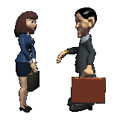
Clauses with because
I would make a good lawyer because I´m very persuasive.

Slide 14
Clauses with because
Why do we have teeth?
Why do we wear shoes?
Why do children go to school?
Why do we wear sunglasses?
Why do we take a bath?
Why do we eat?
Why do we sleep?

Slide 15
END

