Slide 1
How do you feel? I feel………
Amina Akorede (2021)

Slide 2
Excited

Slide 3
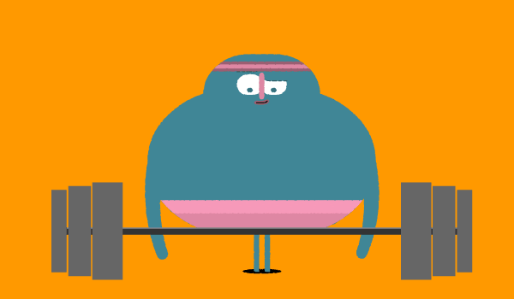
Strong

Slide 4
Surprised

Slide 5
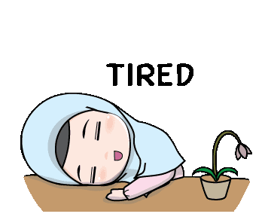
Tired

Slide 6
Happy

Slide 7
Shy

Slide 8
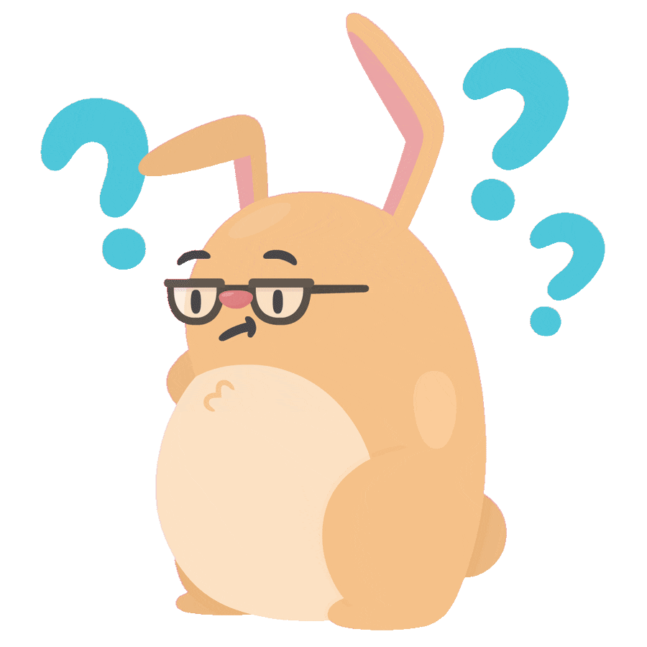
Confused

Slide 9
Worried

Slide 10
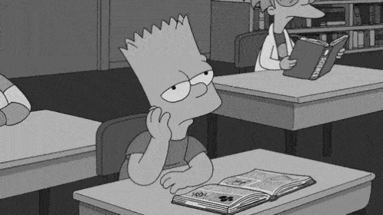
Bored

Slide 11
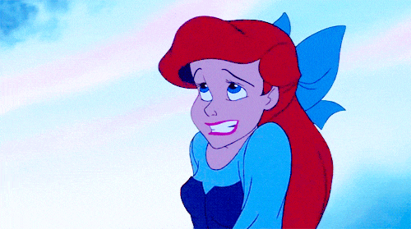
Ashamed

Slide 12
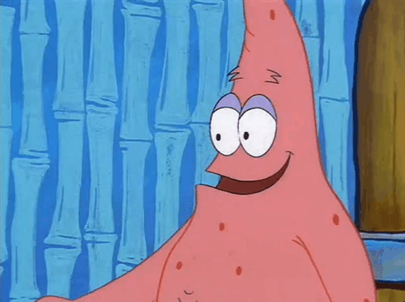
Disgusted

Slide 13
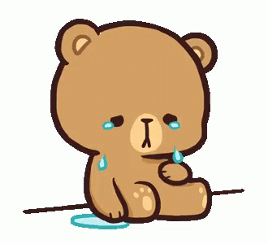
Sad

Slide 14
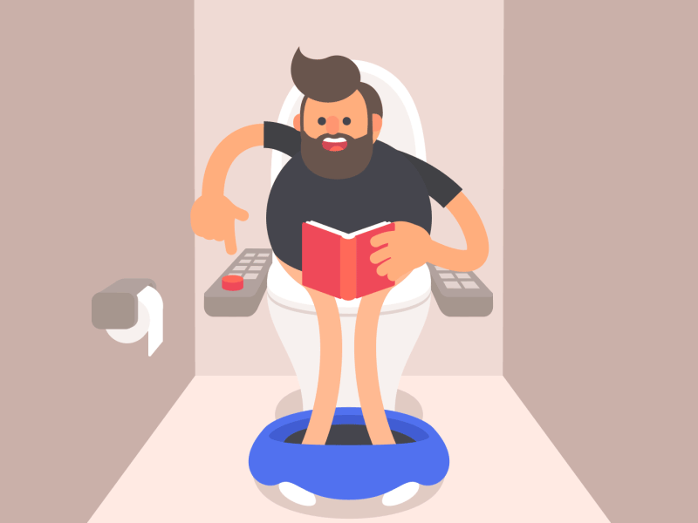
Inspired

Slide 15
END

