Slide 1
True or false
Amina Akorede (2021)

Slide 2
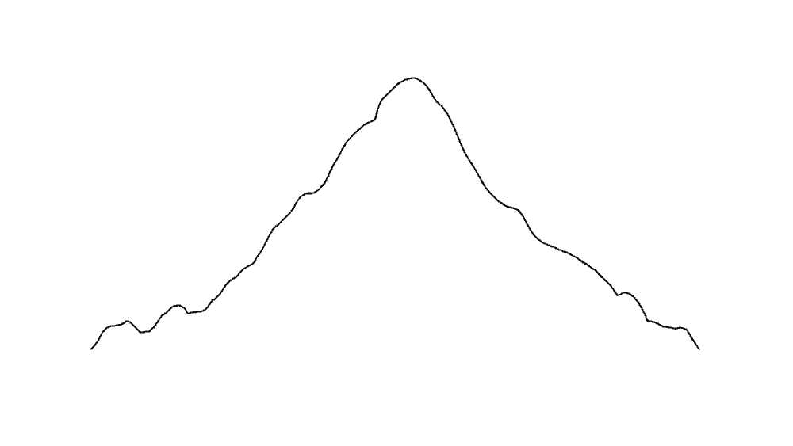
1. Mount Kilimanjaro is the highest mountain in the world?
False
( It’s Everest)

Slide 3
2. The Earth is 4.5 billion years old.
True

Slide 4
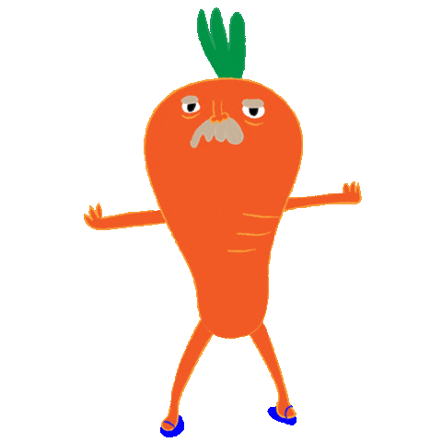
3. Carrots are only orange in color.
False
( Most carrots are orange in colour but there can be red, white, yellow and purple carrots as well)

Slide 5
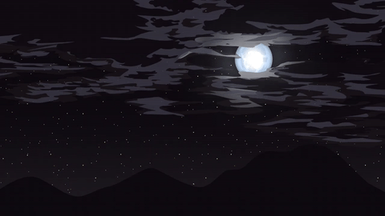
4. When you look at the night sky, you are looking into the past.
True

Slide 6
5. The USA is the most visited country in the world.
False
( France)

Slide 7
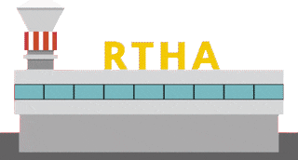
6. One third of all the airports in the world are located in Europe.
False
( In the US)

Slide 8
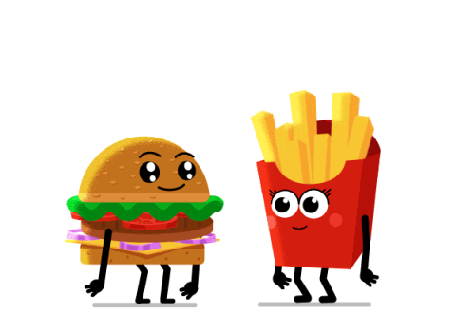
7. There are no McDonald's restaurants in Jamaica.
True

Slide 9
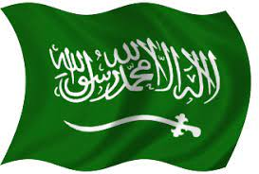
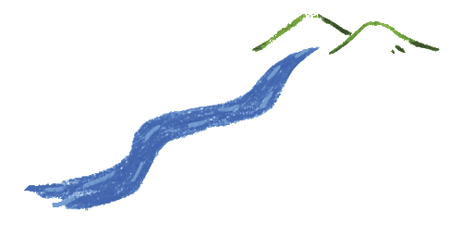
8. Saudi Arabia is the only country in the world not to have any river.
True

Slide 10
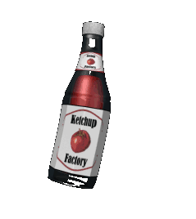
9. Ketchup was used as a medicine in the
early 19th century.
True
( American physicians concentrated tomato ketchup into pills,
as it helped treat diarrhea and indigestion. )

Slide 11
10. Every day, nearly 200 banks are robbed.
False
( luckily, only 20 banks)

Slide 12
11. An average four-year-old child asks over four
hundred questions a day.
True
( little children are usually curious)

Slide 13
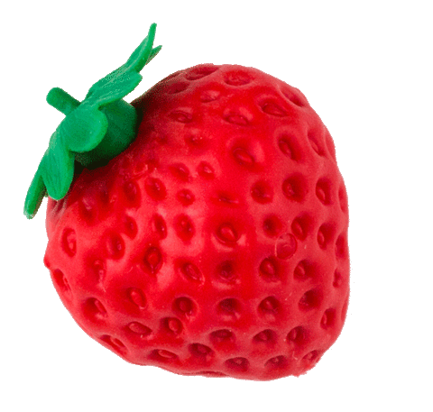
12. Strawberries belong to the rose family.
True
(Strawberries, along with plums and apples,
belong to Rosaceae, the rose family of plants)

Slide 14
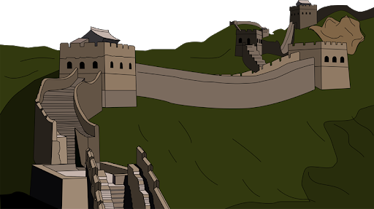
13. The Great Wall in China can be seen from space.
False
( It’s just a rumour)

Slide 15
END

